Slide 1
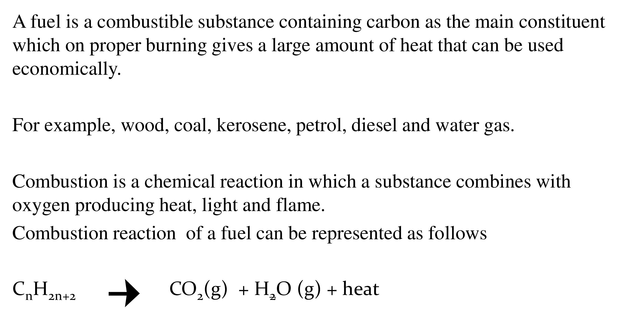
Fuels

Slide 2
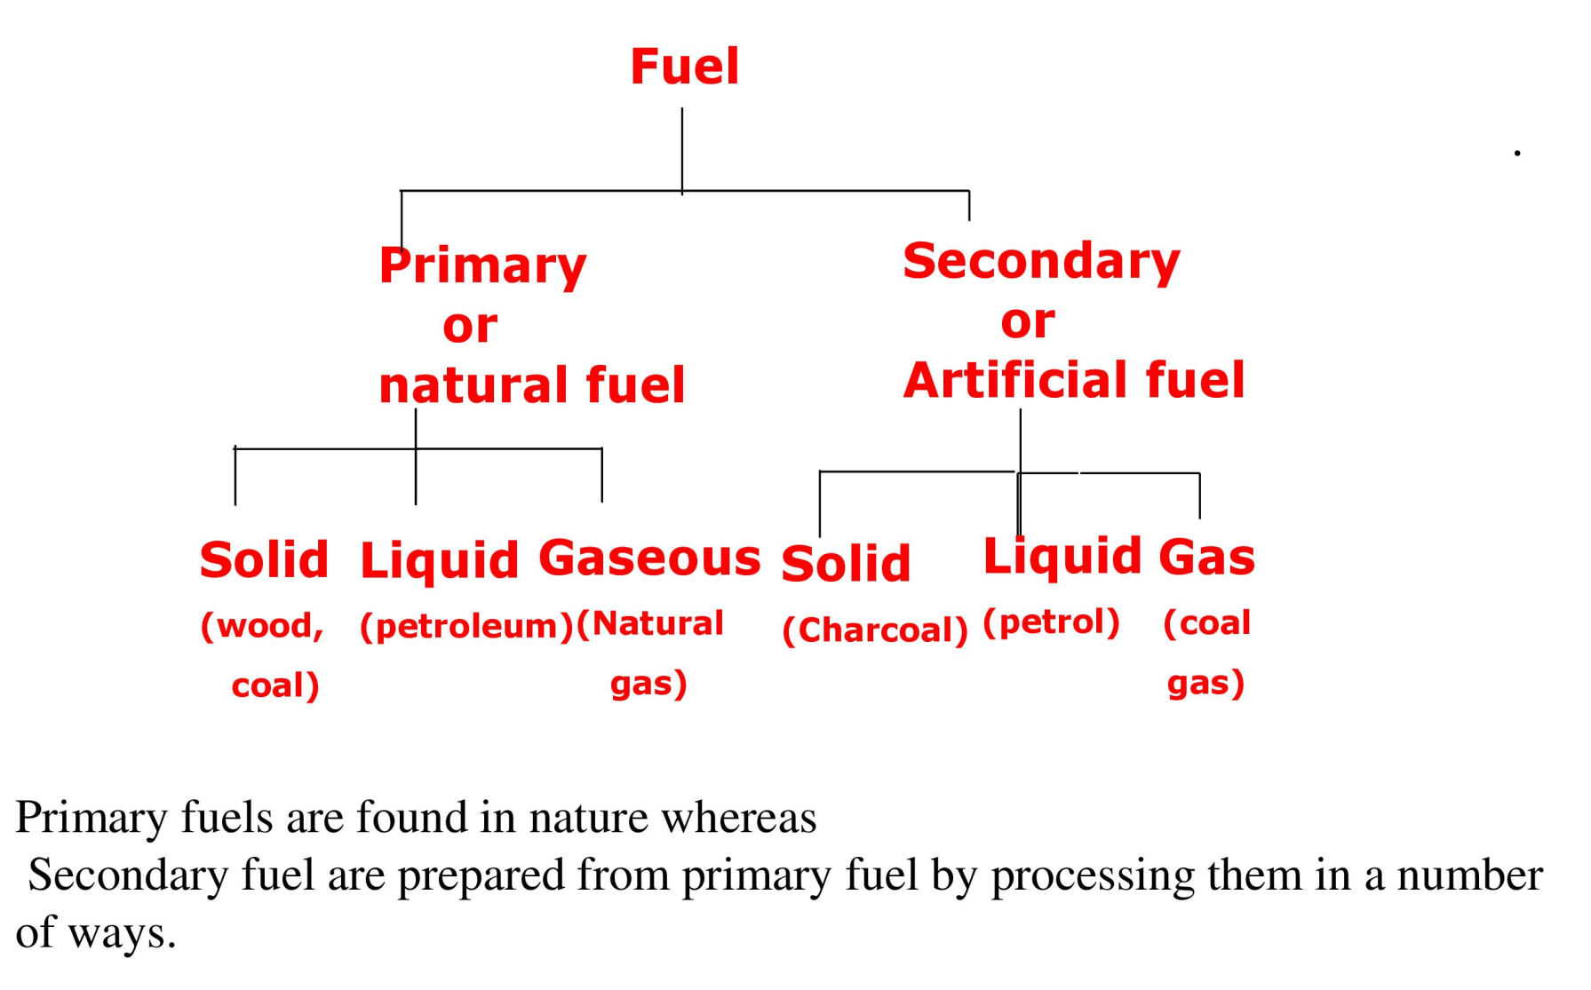
Classification of Fuels

Slide 3
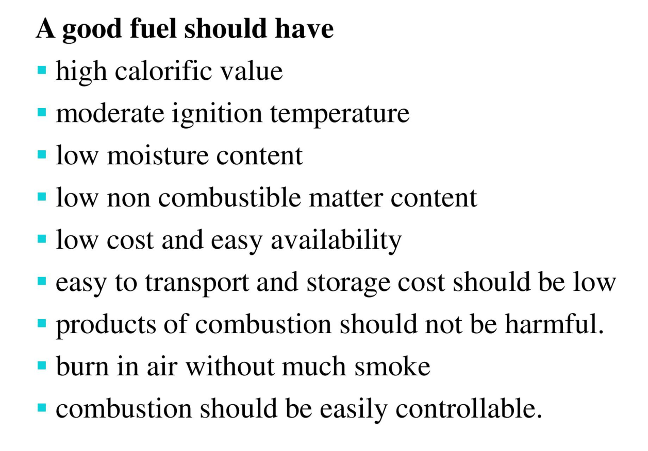
Characteristics of Good Fuel

Slide 4
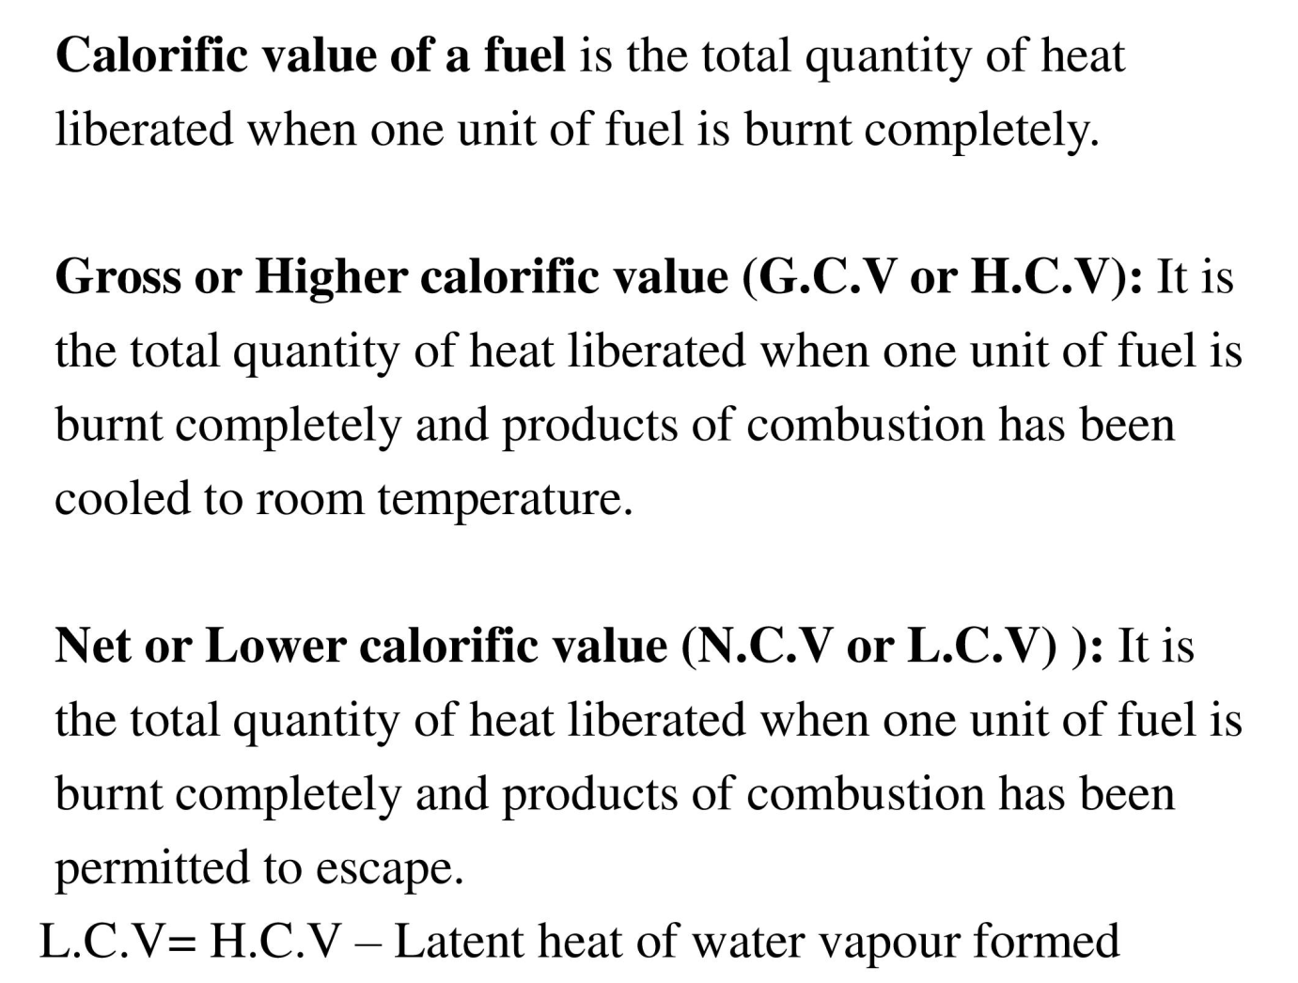
Calorific Value

Slide 5
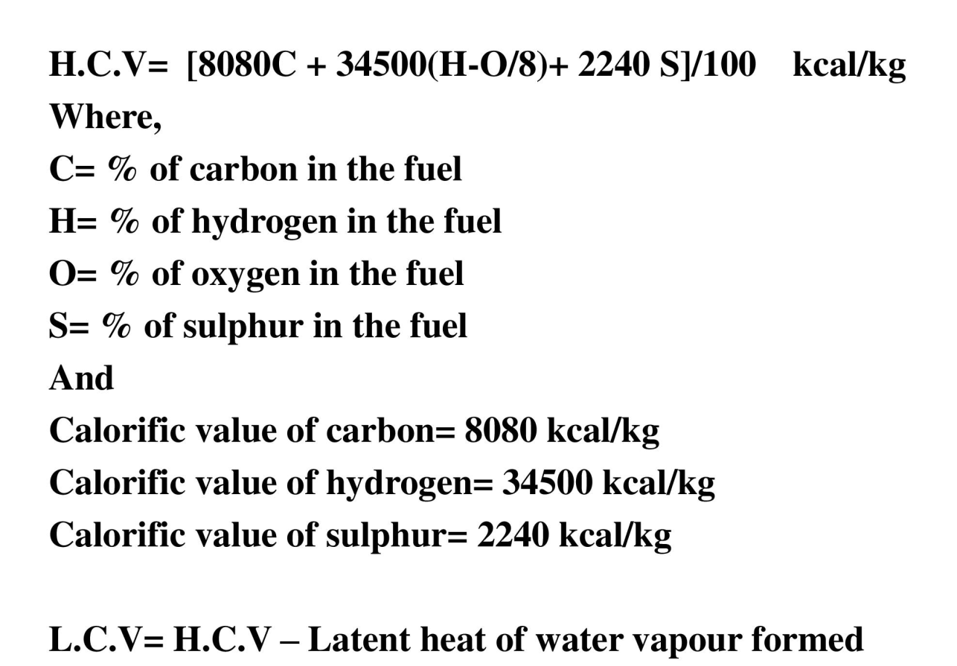
Theoretical calculation of Calorific value using Dulong’s Formula
LCV= HCV- 0.09H x 587 kcal/kg

Slide 6
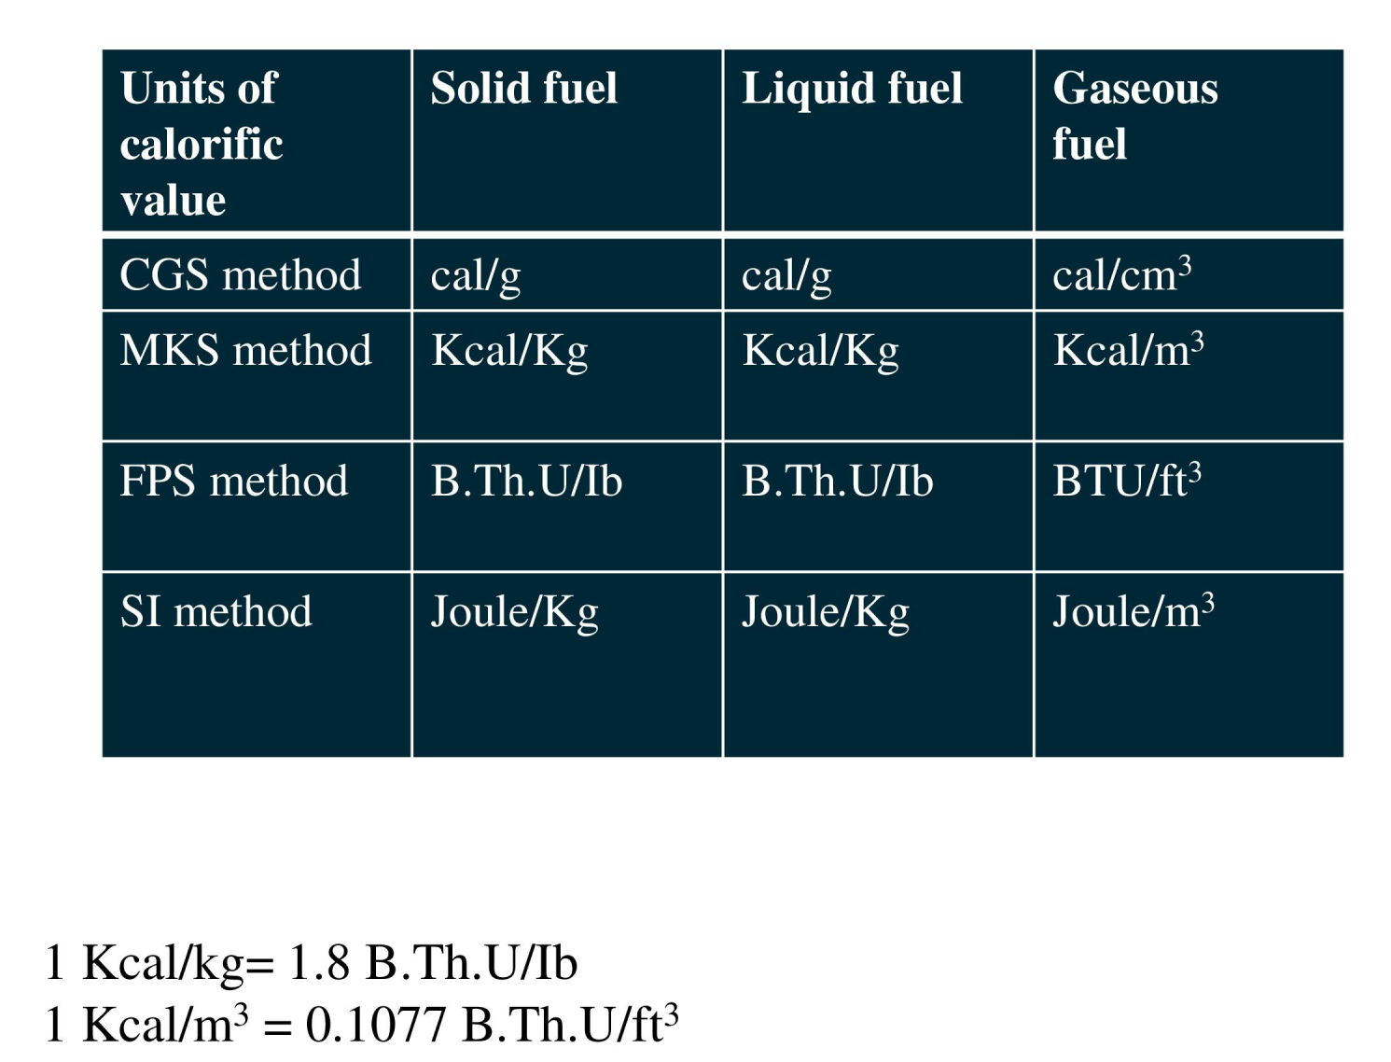
Units of Calorific Value

Slide 7
The Calorie, a unit of heat may be defined as, the heat required to raise the temperature of 1kg of water from 15ºC to 16ºC.
A British Thermal Unit may be defined as, the heat required to raise the temperature of one pound of water from 60ºF to 61ºF.
1BTU = 2.252Kcal = 2252cal
1kcal = 1000cal
1kcal = 3.968BTU
Centigrade Heat unit is the heat required to raise the temperature of 1pound water through 1 degree centigrade.
1kcal = 2.2CHU = 3.968BTU
1kcal/kg = 1.8BTU/lb
1kcal/m³ = 0.1077BTU/ft³
1BTU/ft³ = 9.3kcal/m³

Slide 8
Numerical:
Convert 450cal/gm into- a. kcal/kg b. BTU/lb c. kcal/m³ d. BTU/ft³ e. CHU/lb.
Solution: a. 450kcal/kg b. 810BTU/lb c. d. e. 449.09CHU/lb
2. Calculate the gross and net calorific values of a coal sample having the following composition C = 80%; H = 7%;O = 3%; S = 3.5%; N = 2.5% and ash 4.4%
Solution
(I) G.C.V = 1/100[8080*%C+34500(%H - O/8)+2240*%S] kcal/kg
= 1/100[8080*80+34500(7 - 3/8)+2240*3.5] kcal/kg
= 8828.0 kcal/kg
(II) N.C.V = G.C.V – [0.09H*587] kcal/kg
= 8828 – [0.09*7*587] kcal/kg
= 8458.2 k cal/kg

Slide 9
Numerical:
3. A sample of coal contains: C= 60%, O= 33%, H= 6%, S= 0.5%, N= 0.3%, Ash= 0.2%. Calculate GCV and NCV.
Solution: GCV= 5506.075Kcal/kg, NCV= 5216.095Kcal/kg
4. A sample of coal contains C= 70%, O= 8%, N= 3%, S= 2% and Ash. If LCV is 8277.50Kcal/kg, find HCV and %H.
Solution: %H= 9.84 HCV= 8750.60 Kcal/kg
5. A sample of coal contains C= 61%, H= 6%, S= 0.5%, N= 0.2%, Ash= 0.3%. Calculate GCV and NCV.
Solution: %O= 32 GCV= 4250 Kcal/kg NCV= 3933.02 Kcal/kg

Slide 10
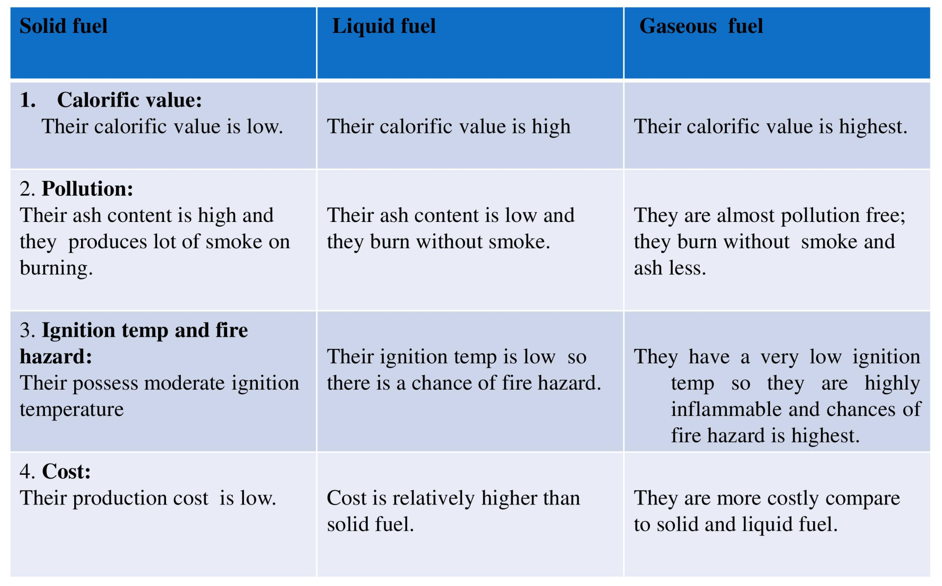
Comparison of Solid, Liquid and Gaseous Fuels

Slide 11
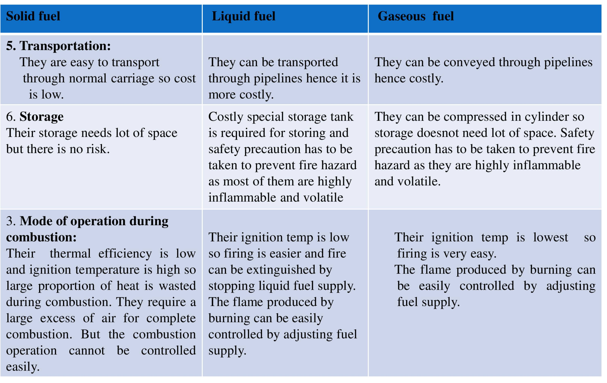

Slide 12
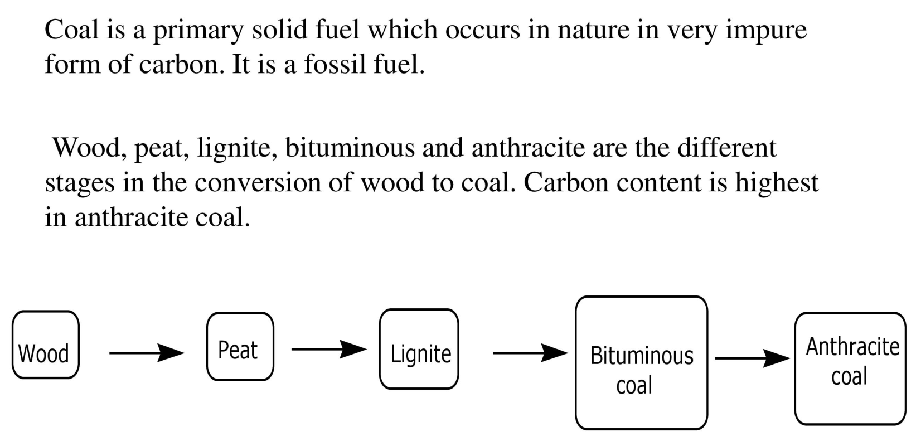
Solid Fuel
Classification of Coal

Slide 13
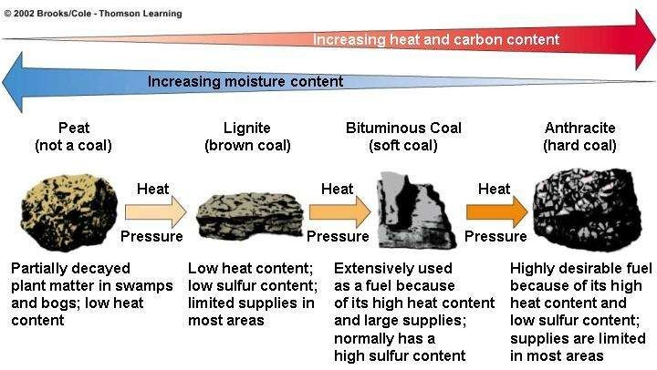
Coal formation process

Slide 14
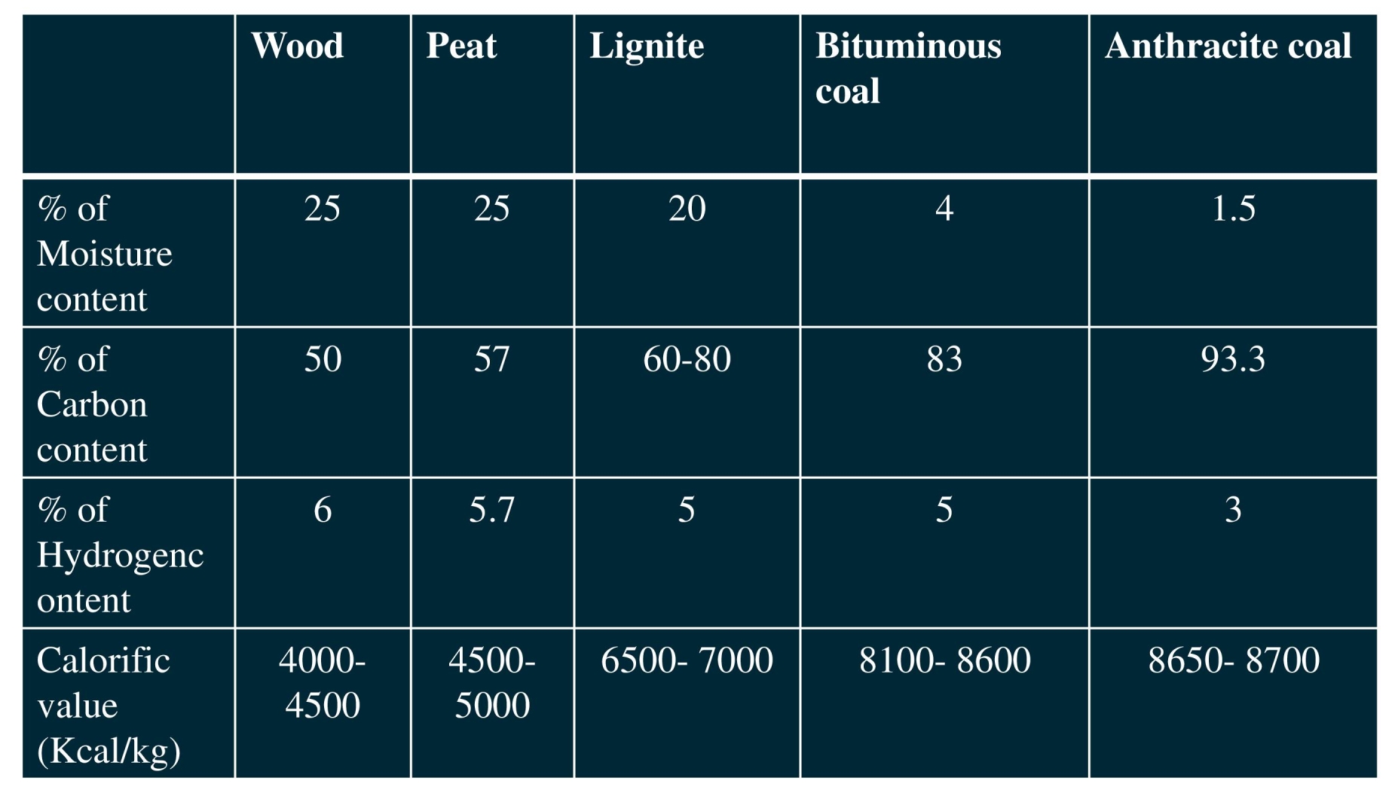
Classification of Coal

Slide 15
Analysis of coal:
The purpose is to-
To decide the price of coal.
To determine the quality of coal.
To specify the use of coal for a particular purpose.
To calculate the theoretical calorific value of coal.
To calculate the air requirement for complete combustion of coal and design the furnace fir box suitably.

Slide 16
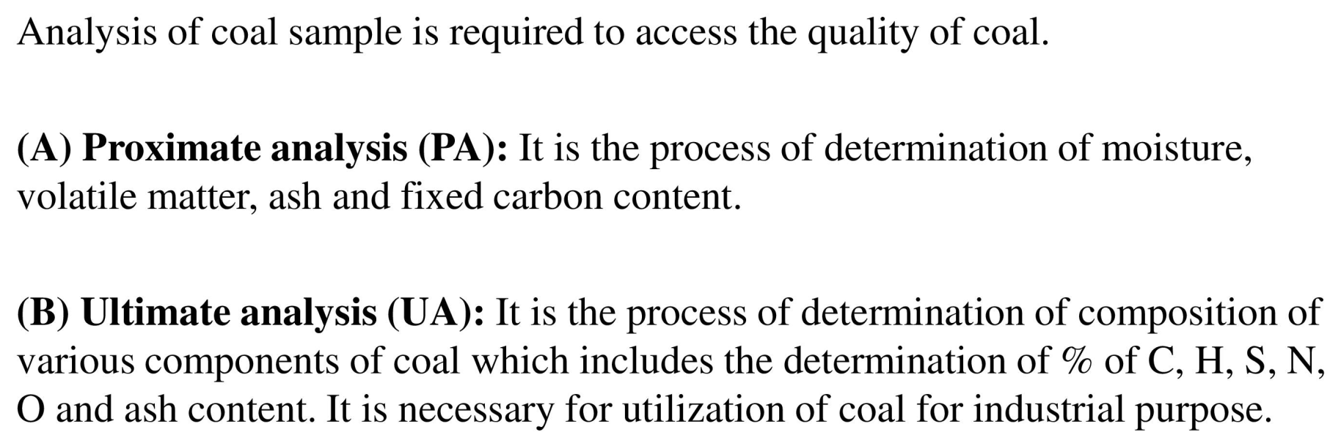

Slide 17
The significance of various parameters of proximate coal analysis:
Moisture :
Moisture increases transportation, handling, storage cost
Moisture decreases the heat content per kg of power plant coal
Moisture increases heat loss due to evaporation and superheating of vapor
Moisture helps in binding the fines
Moisture helps in radiation heat transfer
Volatile matter:
Volatile matter also contributes to the heating value of coal
Increase in percentage of volatile matter in coal proportionately increases flame length (smoky flame) and helps in easier ignition of coal
Sets of minimum limit of furnace height and volume
Influences secondary oil support
Ash:
Ash is an impurity which will not burn
Ash content is important in design of furnace grate, combustion volume, pollution control equipment (ESP) and Ash handling plant
Ash increases transportation, handling, storage cost
Ash affects combustion efficiency and boiler efficiency
Ash causes clinkering and slagging problems in boiler
Fix carbon:
Fix carbon acts as a main heat generator during burning.
Fix carbon gives a rough estimate of heating value of coal

Slide 18
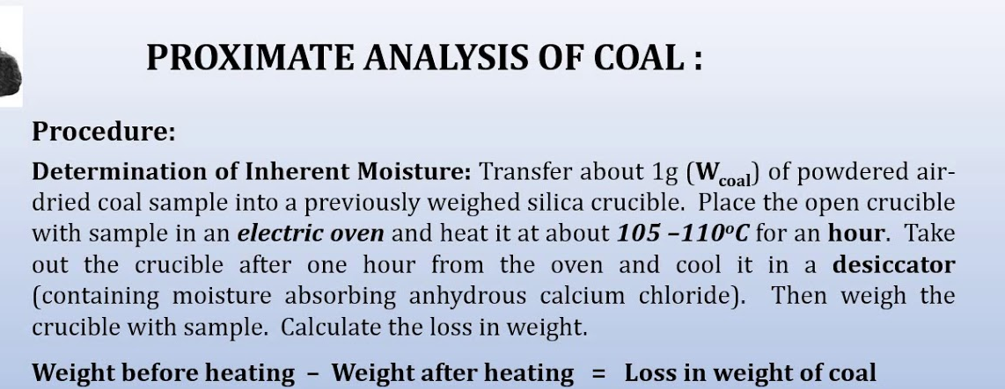
%Moisture = Loss in weight x 100
Weight of Coal

Slide 19
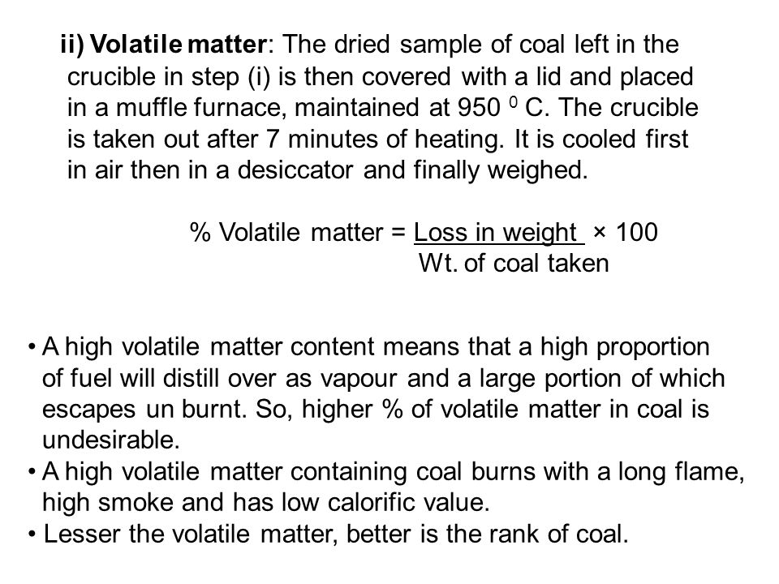
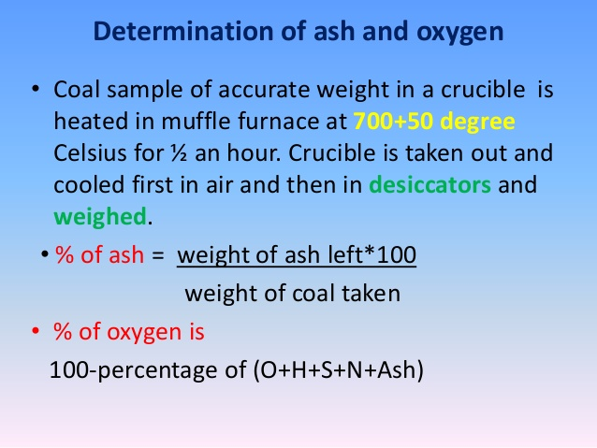

Slide 20
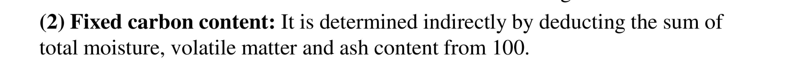
%FC = 100 – (%M + %VM + %Ash)
Numerical:
A sample of coal is analyzed as follows: Exactly 2.5 g was weighted into silica crucible. After heating for an hour at 110˚C, the residue weighed 2.415g. The crucible next was covered with a vented lid and strongly heated for exactly seven minutes at 950˚C. The residue weighed 1.528g. The crucible was then heated without the cover, until a constant weight was obtained. The last residue was found to weigh 0.245g. calculate the percentage result of above analysis.

Slide 21
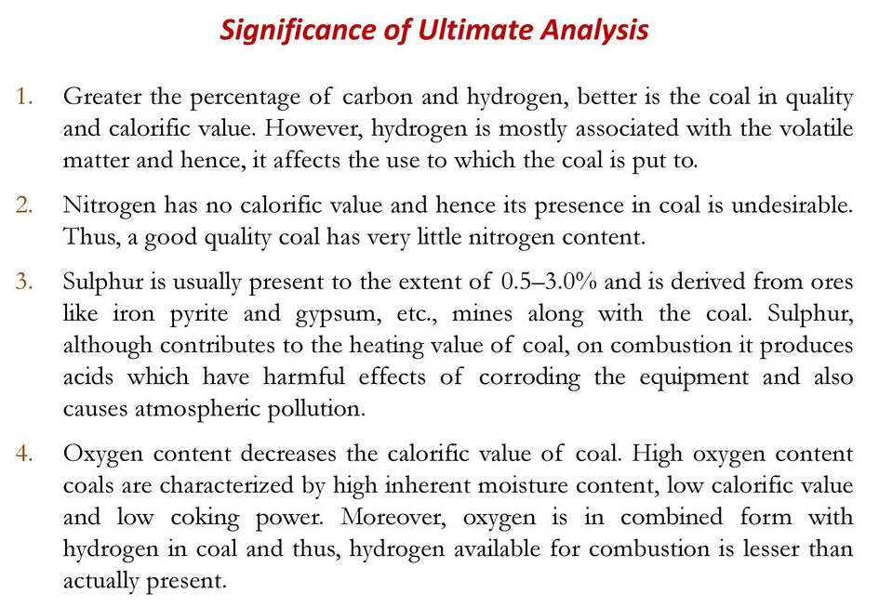

Slide 22
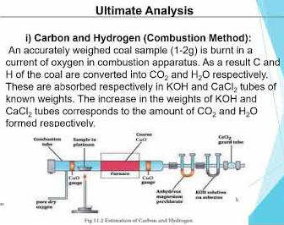

Slide 23
C + O₂ → CO₂; H₂ + ½ O₂ → H₂O
(44) (2) (18)
2KOH + CO₂ → K₂CO₃ + H₂O; CaCl₂ + 7 H₂O → CaCl₂.7H₂O
So, %C = Increase in wt. of KOH tube x 12 x 100
Wt. of coal sample x 44
%H = Increase in wt. of CaCl₂ tube x 2 x 100
Wt. of coal sample x 18

Slide 24
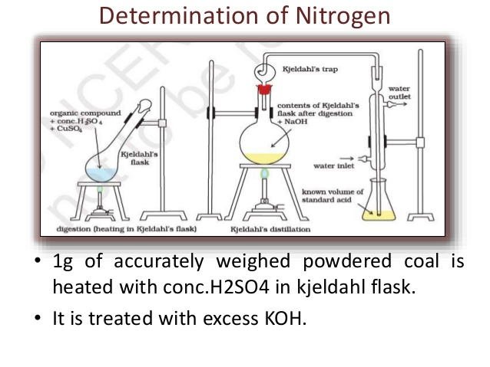

Slide 25
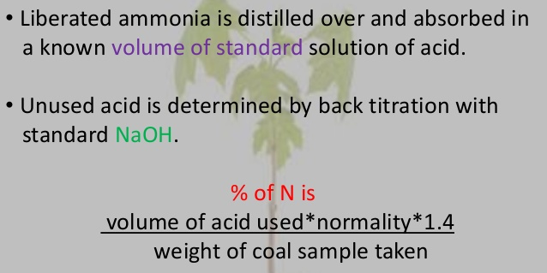

Slide 26
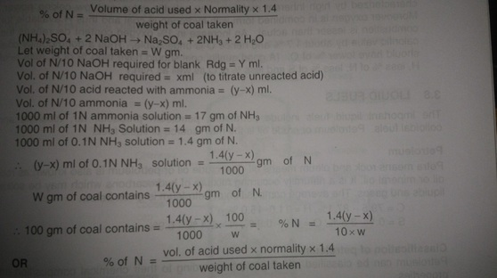

Slide 27
Determination of Sulphur:
Take 10ml of distilled water in a bomb calorimeter. Burn the known weight of powdered and air dried coal sample in it. Collect the washings in a beaker and add barium chloride solution to it. Filter the precipitate of barium sulphate formed. Dry it and weigh it. Calculate the %S as-
BaCl₂
S → SO₂ → SO₃→H₂SO₄ → 2HCl + BaSO₄
32 233
%S = Weight of BaSO₄ ppt x 32 x 100
Weight of coal sample 233

Slide 28
C

Slide 29
Numerical:
1. 0.2g of coal sample is burnt. The gaseous products are absorbed in potash bulb and calcium chloride tube of known weight. The increase in weight of potash bulb and calcium chloride tube are 0.66gm and 0.08gm respectively. Calculate %C and %H. (Solution: C= 90%; H= 4.44%)
2. 3gm of coal was heated in Kjeldahl’s flask and ammonia formed was absorbed in 40ml of 0.5N acid. After absorption, the excess acid required18.5ml of 0.5N KOH for neutralization. 2.3gm of same coal sample gave 0.35gm BaSO₄ ppt. Calculate %N and %S. (N= 5.01%; S= 2.089%)

Slide 30
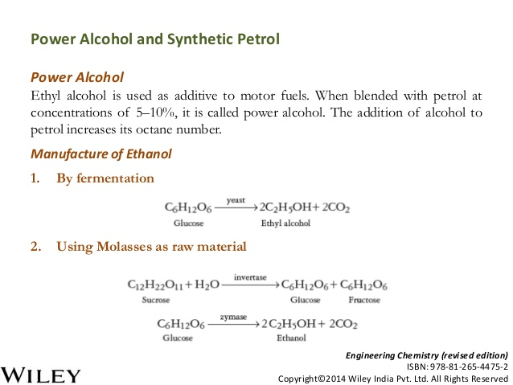

Slide 31
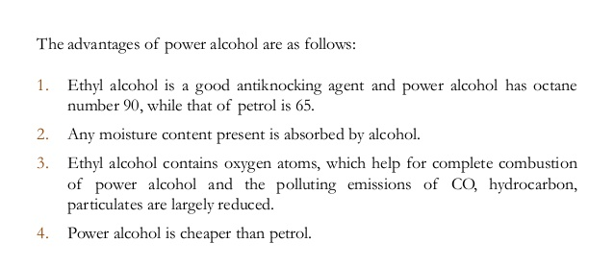

Slide 32
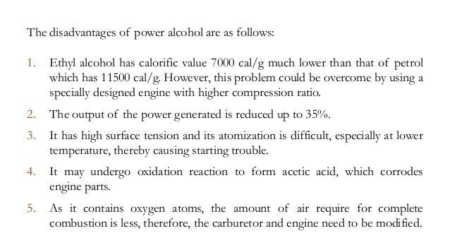

Slide 33
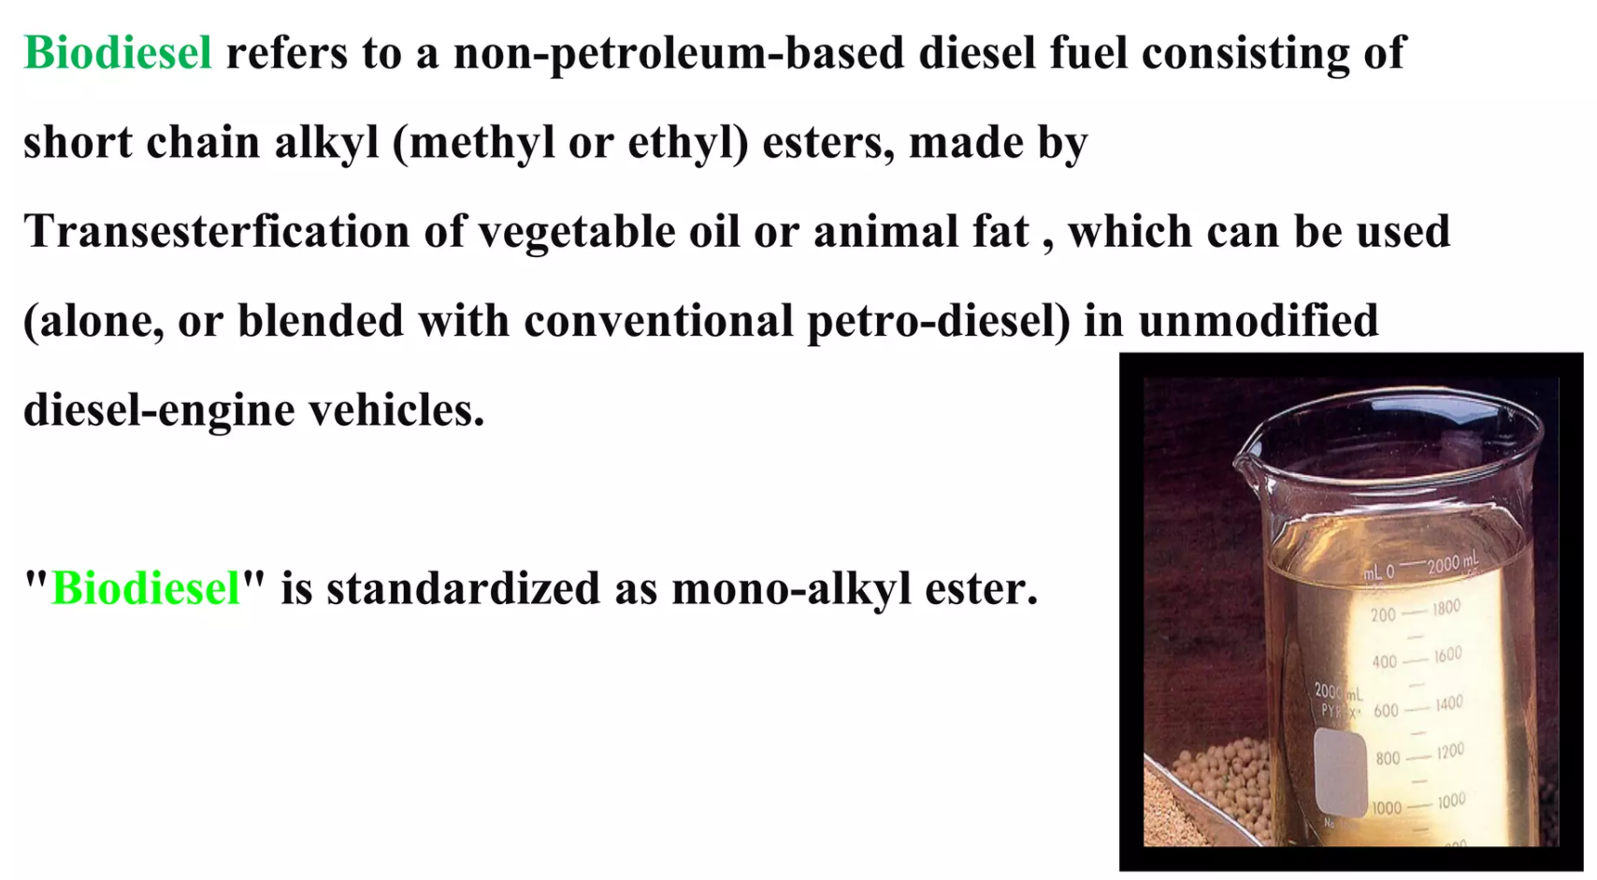
Bio-Diesel

Slide 34

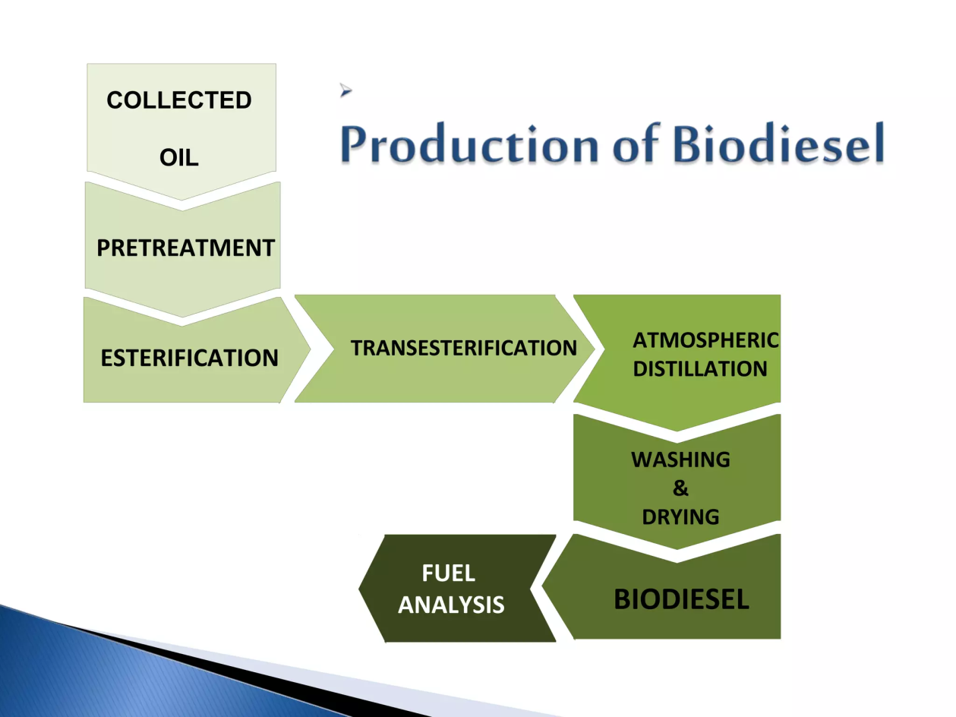

Slide 35
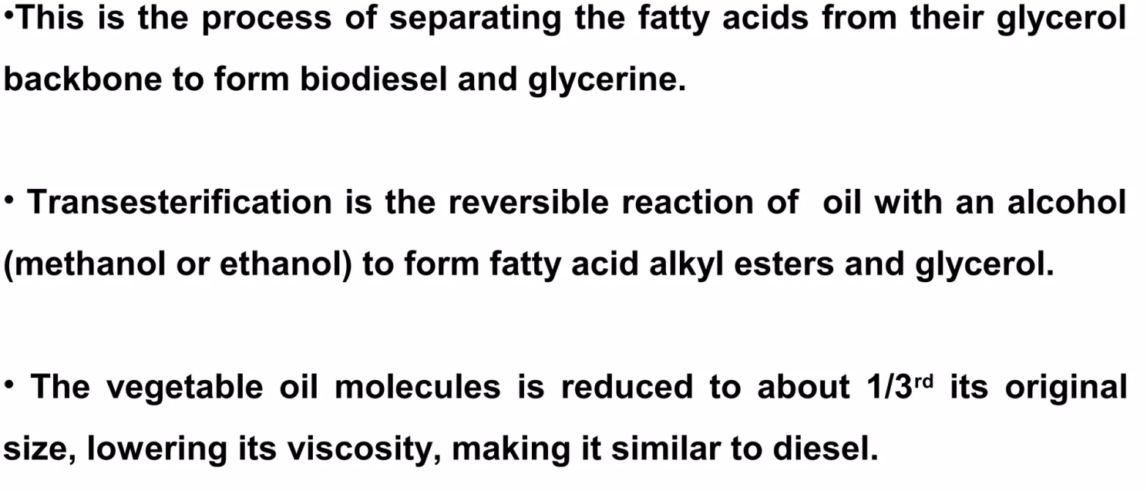
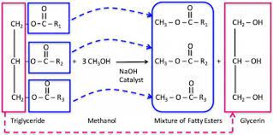
Bio-Diesel

Slide 36
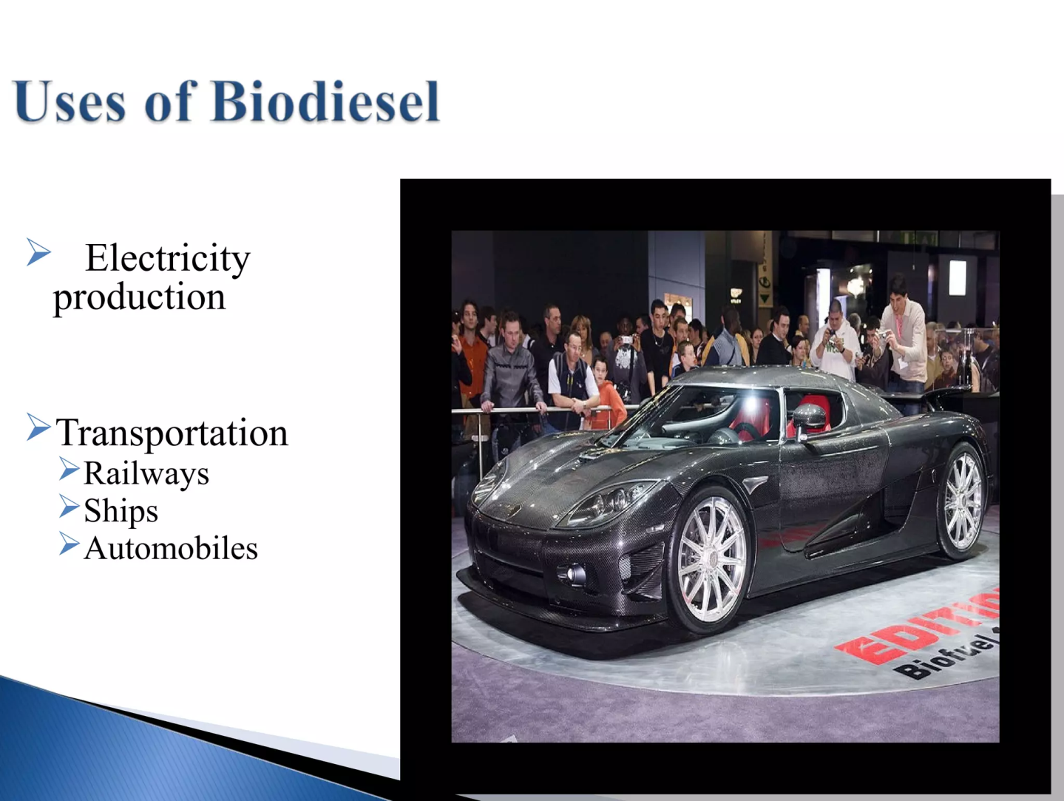


Slide 37


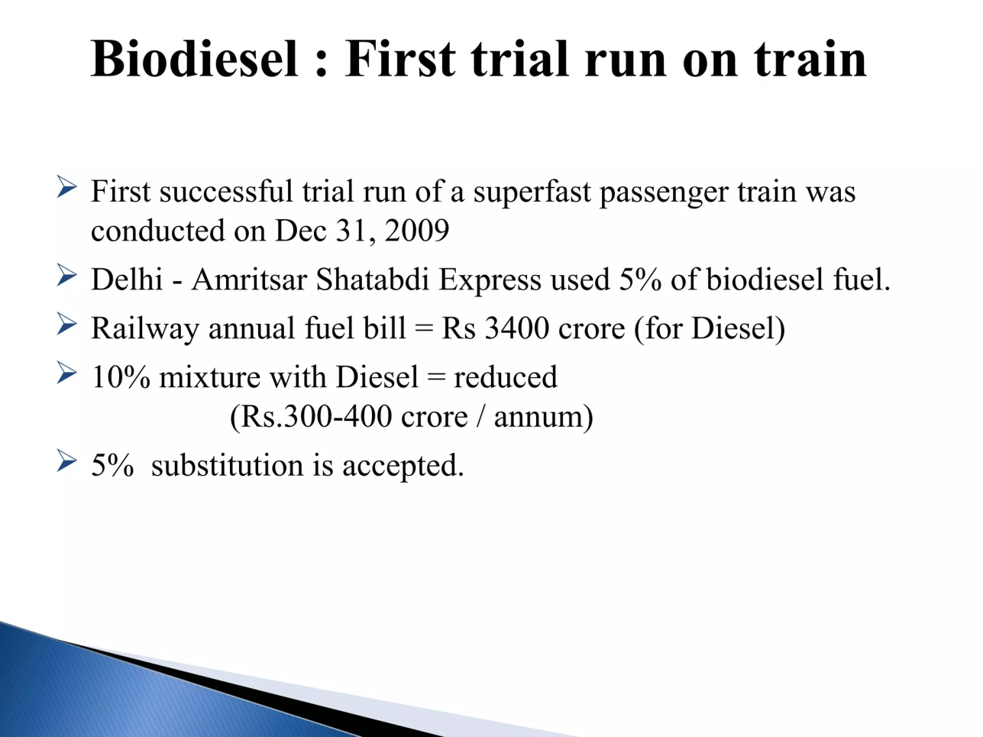

Slide 38
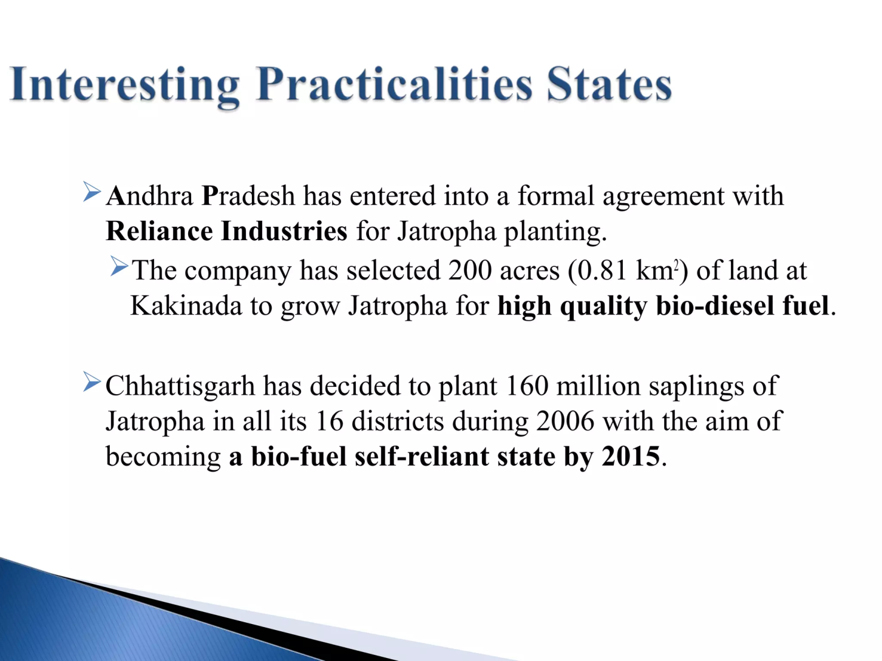
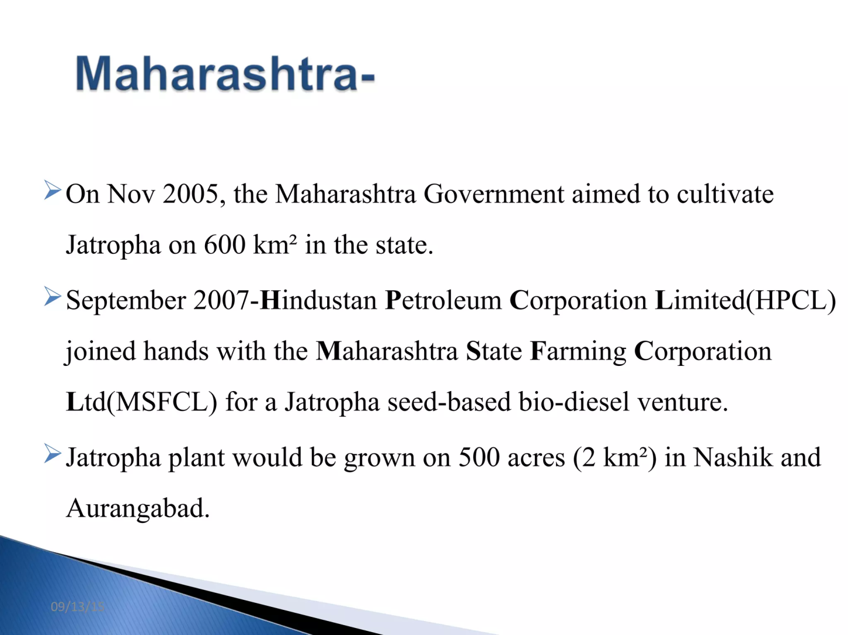

Major Issues

Slide 39
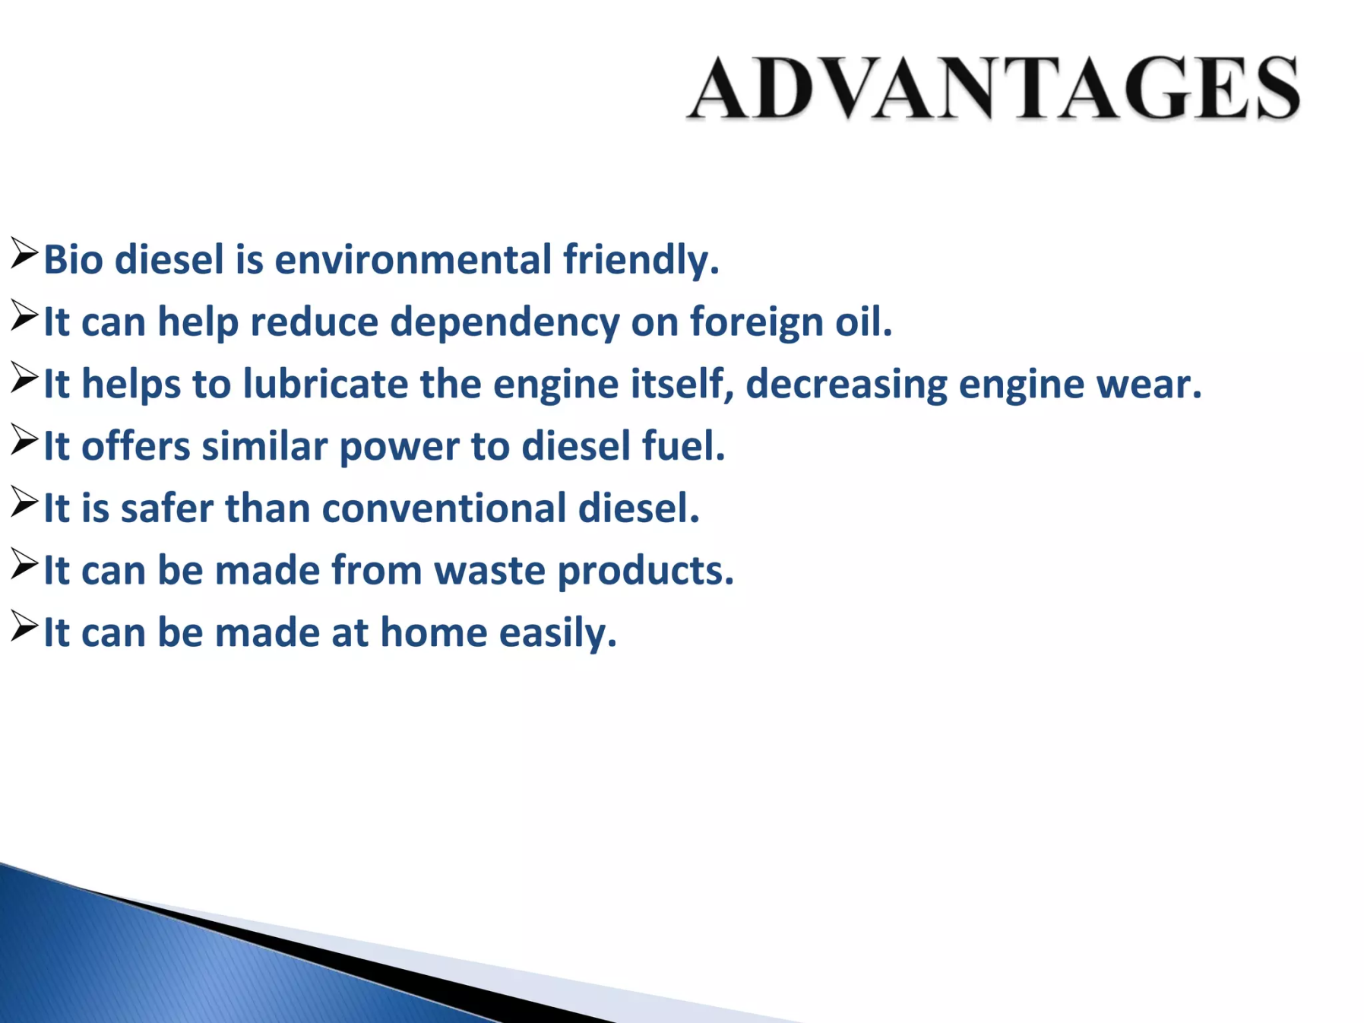
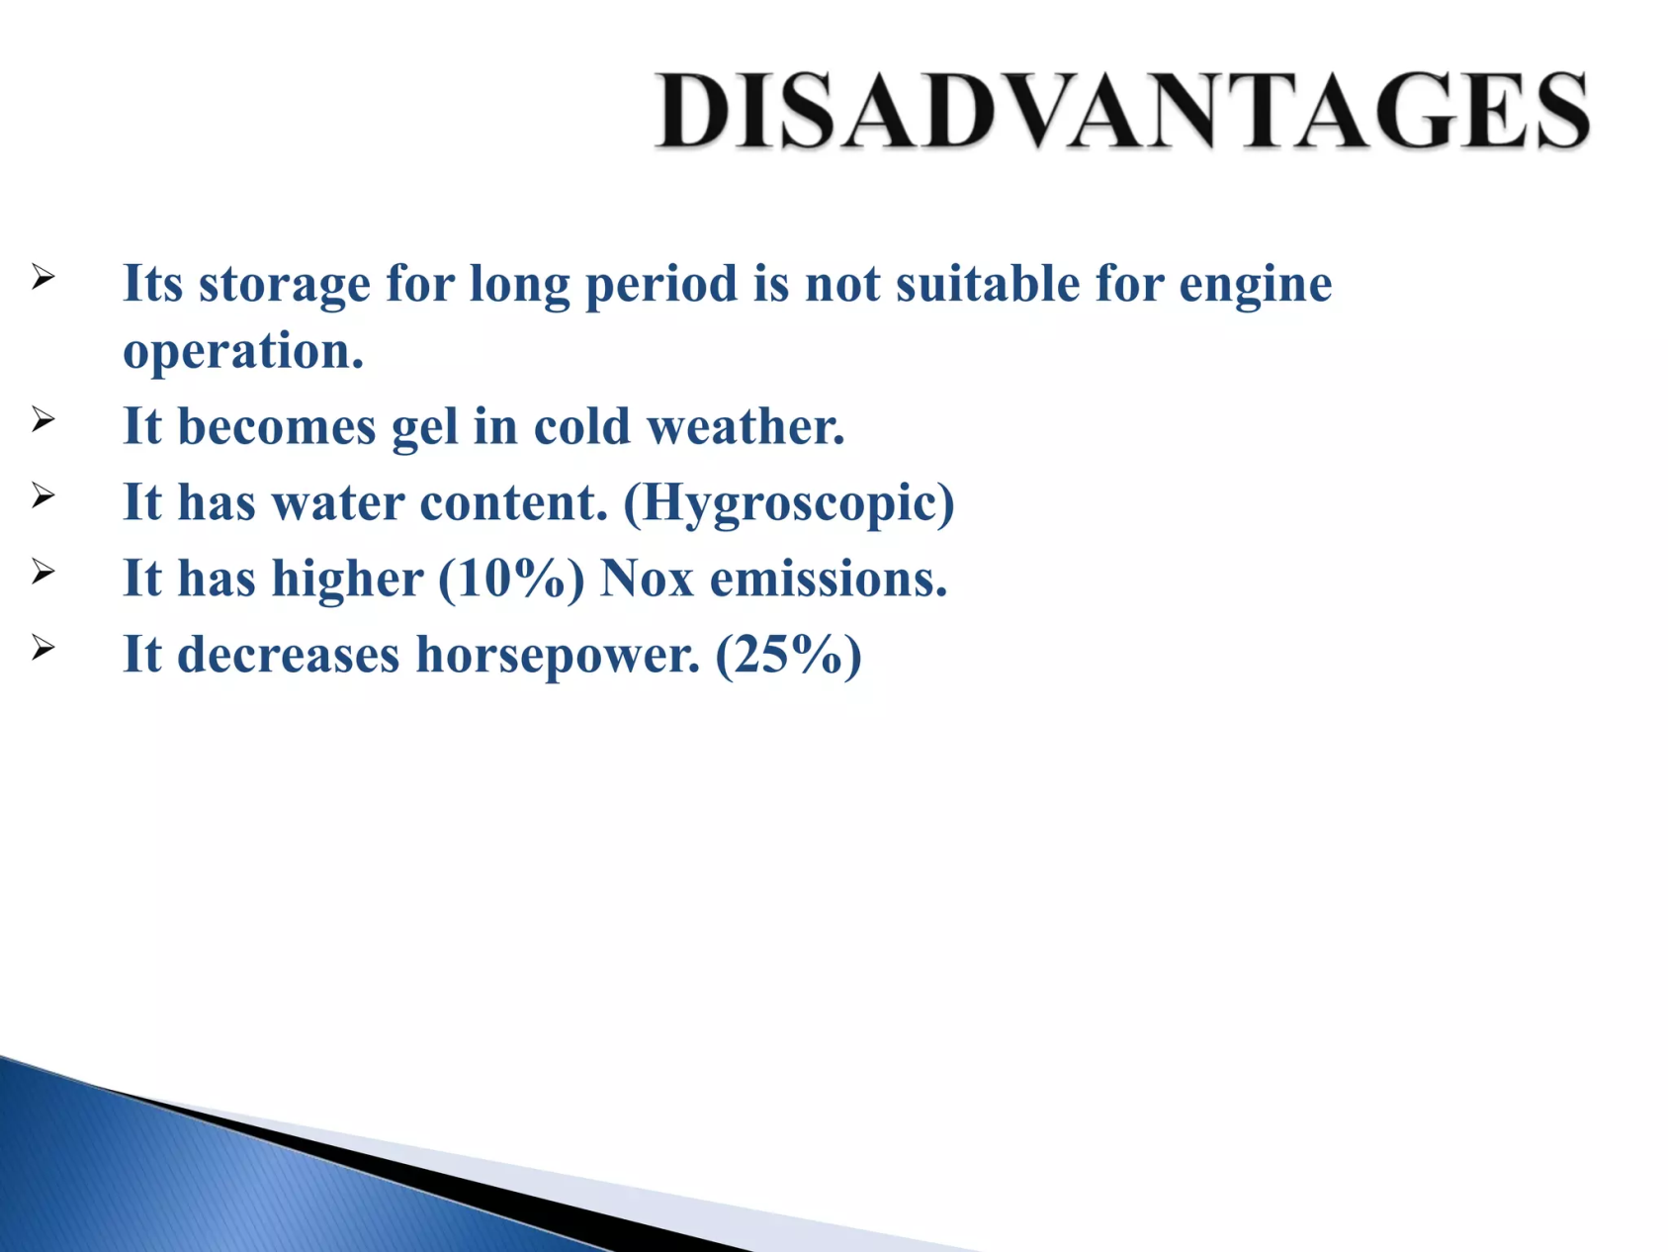
Advantages
Disadvantages

Slide 40
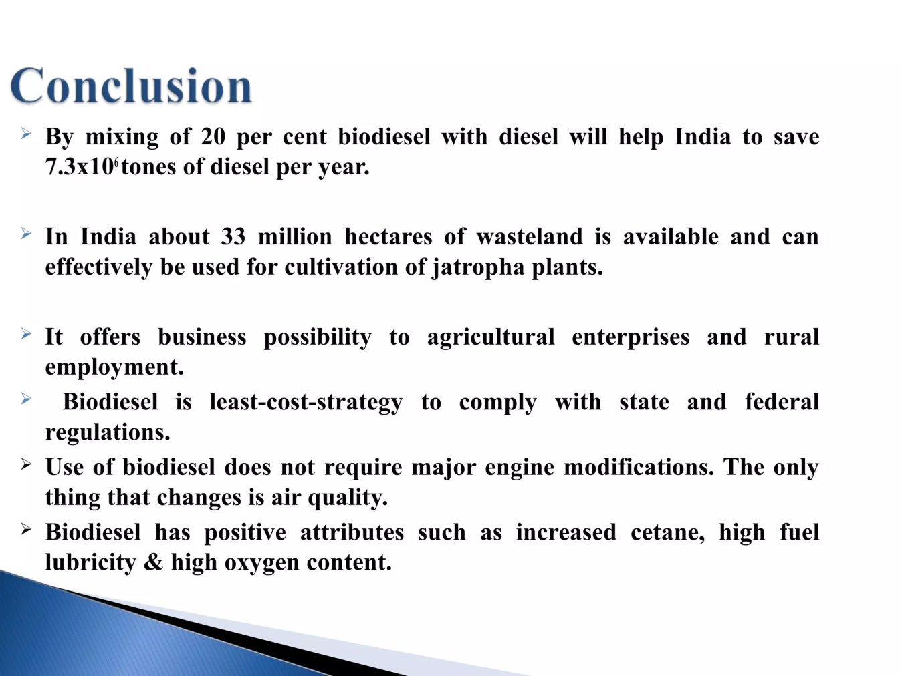
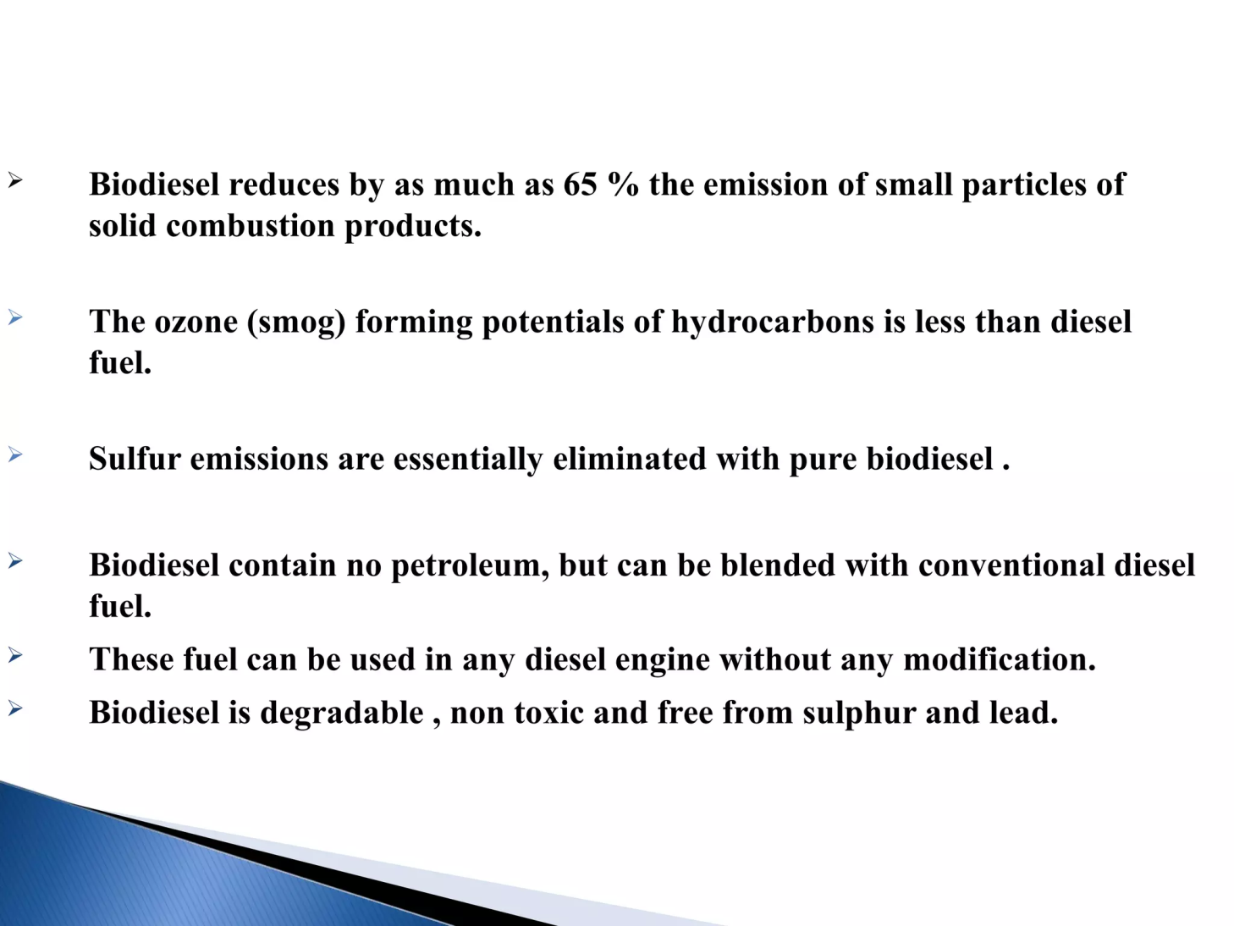

Slide 41
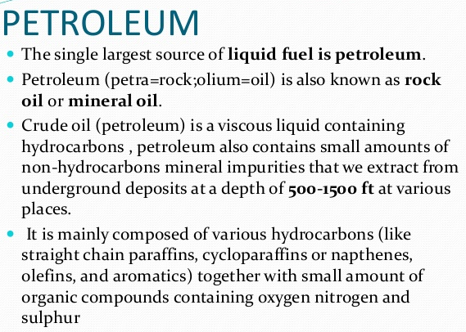
Liquid Fuel

Slide 42
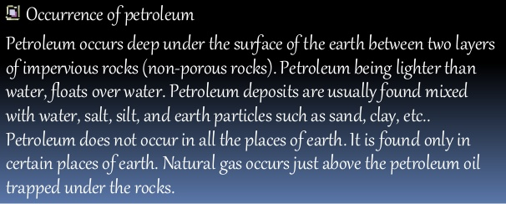
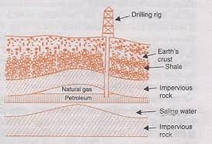
Mining is done by drilling holes in the earth’s crust and sinking pipe upto the oil bearing rock. The hydrostatic pressure exerted by the natural gas helps to get petroleum piped out with pressure. When this pressure falls, oil can be pumped out by forcing air (airlift process) or water (hydro process) through another pipe sinked in the earth’s crust.

Slide 43
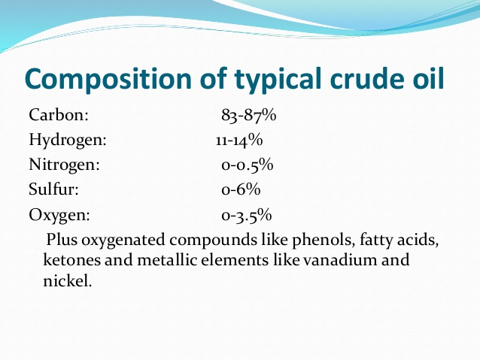
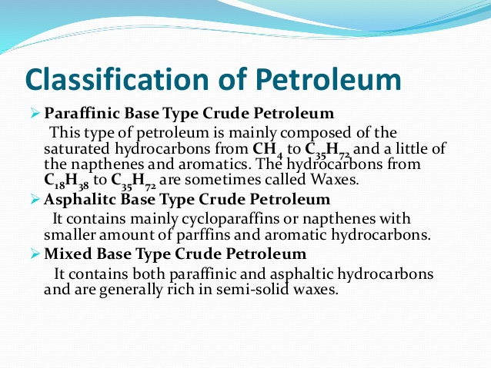

Slide 44
Refining of Petroleum
Crude oil must undergo several separation processes so that its components can be obtained and used as fuels or converted to more valuable products. The process of transforming crude oil into finished petroleum products (that the market demands) is called crude oil refining/ refining of petroleum.
1. Seperation of water and Desalting: The emulsified water alongwith the dissolved salts is removed by passing the crude oil through highly charged electrodes when the colloidal water droplets unite to form large drops which separate from the oil.
2. Removal of Sulphur: The crude oil is then heated with CuO to remove sulphur as CuS.
3. Fractional distillation: The principle of fractional distillation is that vapours of higher boiling point compounds get condensed into liquid during stepwise cooling.

Slide 45
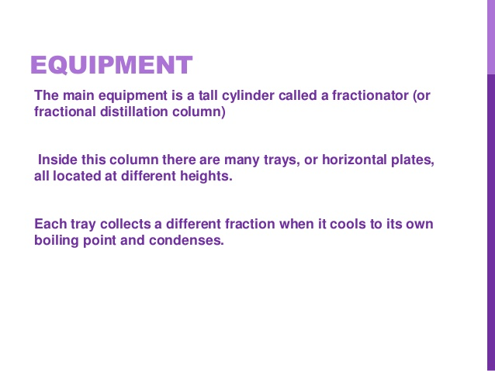
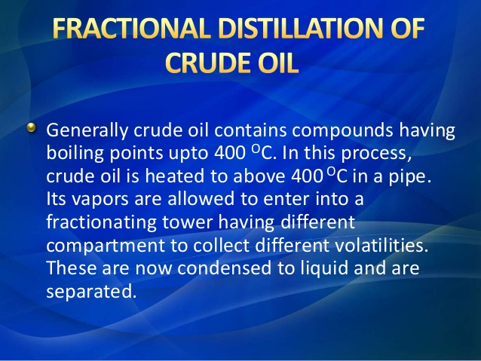
Process

Slide 46
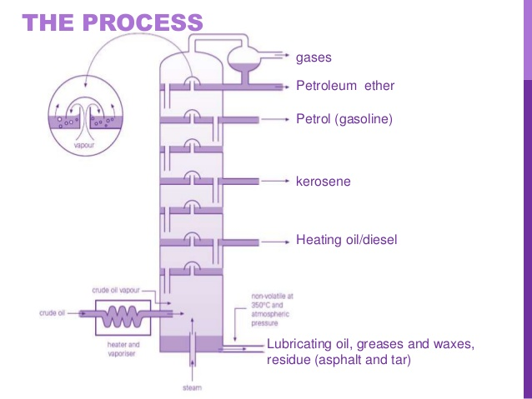

Slide 47
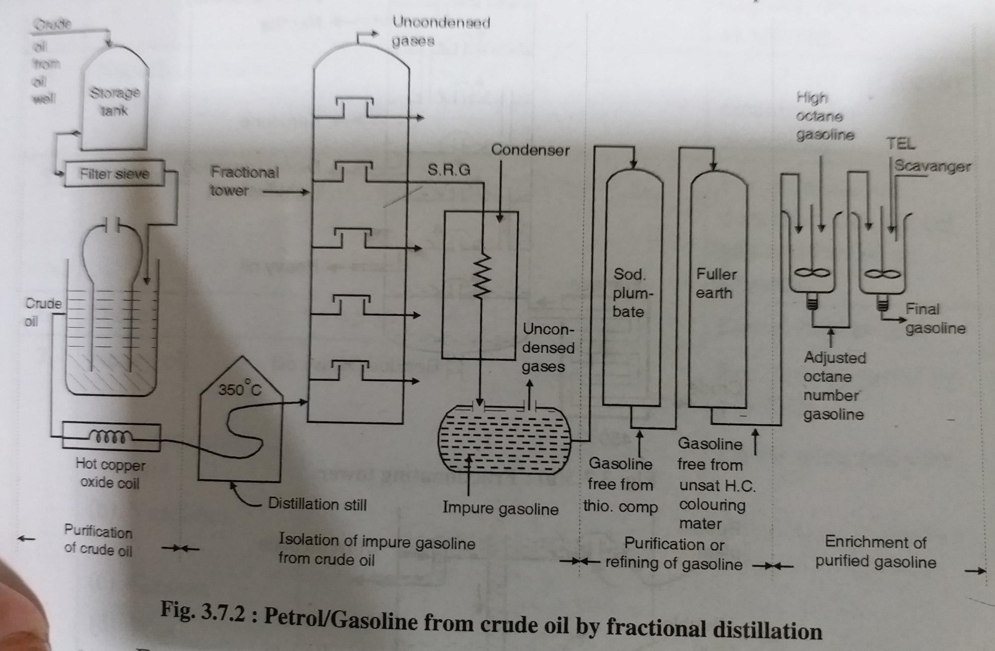

Slide 48
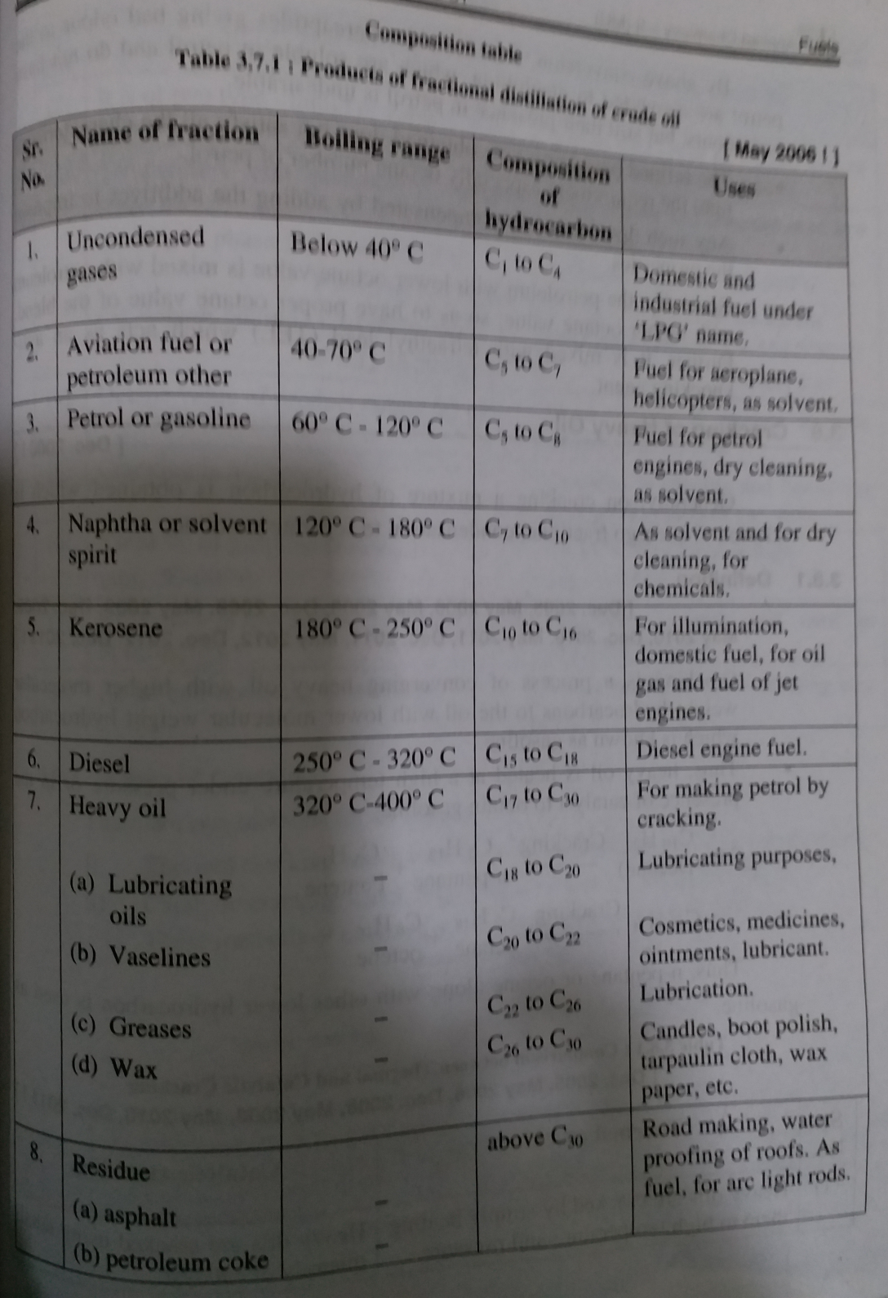

Slide 49
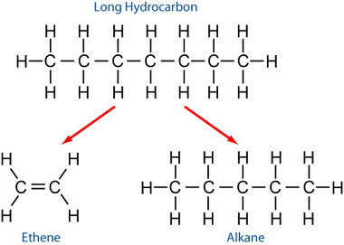
The petrol obtained after fractional distillation is also known as straight run petrol. The yield of petrol is very low. Also, the quality (octane number) is poor.
Thus, various other fractions obtained in the fractional distillation are further subjected to cracking to increase the overall yield and quality of petrol.
The quality of petrol can also be improved by adding various additives to it; like TEL, TML, etc.
Cracking:
Cracking is defined as a process, wherein complex organic molecules namely long chain hydrocarbons or kerogens with high molecular weight are broken down into smaller molecules namely light hydrocarbons with low molecular weight. It is caused by the breaking of carbon-carbon bonds.

